Slide 1
POLYMORPHISM in JAVA
COM2044-B
Object Oriented Programming

Slide 2
Polymorphism?
Another indispensable feature in object-oriented programming
allows programmers to send the same message to objects from different classes
Ex: Consider the statement
account.computeMonthlyFee();
account could be either a SavingsAccount or a CheckingAccount object
If account is a SavingsAccount object
the method computeMonthlyFee defined for the SavingsAccount class is executed
if account is a CheckingAccount object
the method computeMonthlyFee defined for the CheckingAccount class is executed
Sending the same message therefore could result in executing different methods.

Slide 3
Polymorphism?
computeMonthlyFee is called a polymorphic message
since depending on the receiver object, different methods are executed.
Polymorphism helps us write code that is easy to modify and extend

Slide 4
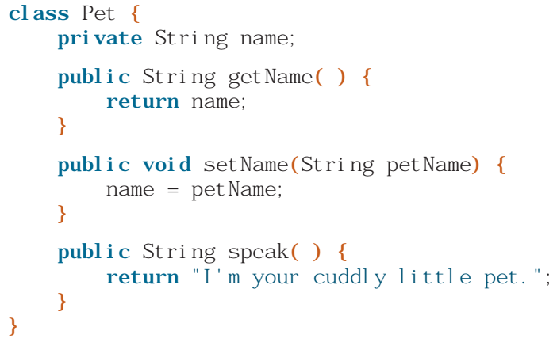

EXAMPLE
begin with a class that models a pet

Slide 5
POLYMORPHISM
There are many different types of pets,
so we really can’t expect one class to be capable of modelling them all.
We all know how different dogs, cats, and reptiles are, for example.
Let’s define the individual Cat and Dog classes to model them a little more precisely than the generic Pet class.
Instead of defining the two new classes independently, we will define them based on the Pet class.
Although they are different, they share common traits of being a pet, so it makes sense to derive the two classes from the Pet class.
We already know that this is inheritance.
We’ll make the Dog and Cat classes inherit the data members and methods of the Pet class.

Slide 6
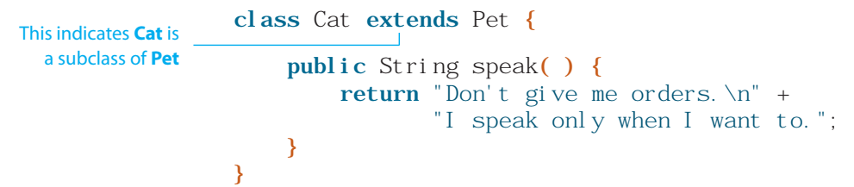
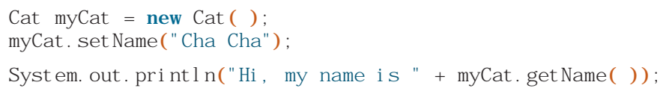
POLYMORPHISM
We know that the Cat class is the subclass or derived class and
the Pet class is the superclass or base class.
We use the reserved word extends to define a subclass.
Data members and methods of a superclass are inherited by its subclasses. So, for example, the following code is valid:

Slide 7
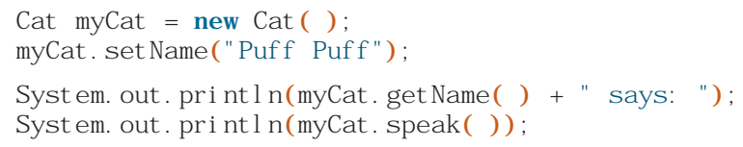

POLYMORPHISM
In the Cat class, we see that the body of the speak method is different. We say the Cat class overrides the speak method. For example, the code
will result in:

Slide 8
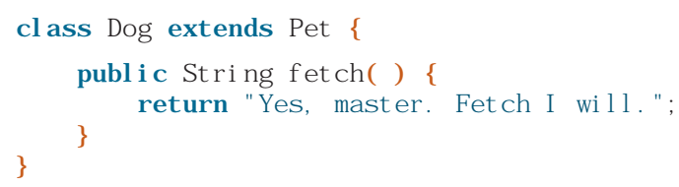
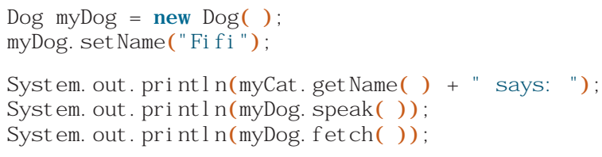
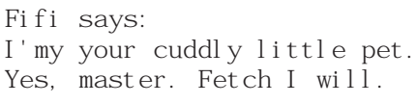
POLYMORPHISM
Let’s define additional methods and data members to a subclass. The following Dog class defines an additional method named fetch:
In addition to using all the inherited methods, we can call the fetch method if it is a dog
myDog

Slide 9

POLYMORPHISM
Now, consider the following code:
Will it work? The answer is ???
When a variable (such as petOne) is declared to be of class S (such as Pet)
the variable can be a reference to an instance of S or any of its subclasses (such as Dog and Cat)
THEREFORE THE ANSWER IS ???

Slide 10
POLYMORPHISM
Now, consider the following code:
Will it work? The answer is YES
When a variable (such as petOne) is declared to be of class S (such as Pet)
the variable can be a reference to an instance of S or any of its subclasses (such as Dog and Cat)
THEREFORE THE ANSWER IS YES

Slide 11

POLYMORPHISM
Will it work?
INVALID!
WHY?
SINCE A PET IS NOT A DOG! IT CANNOT INHERIT FROM A SUBCLASS!

Slide 12
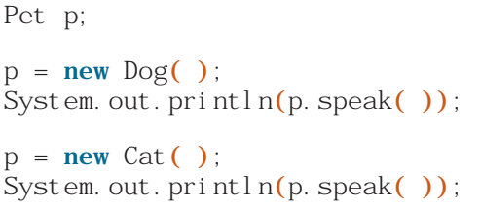
POLYMORPHISM
The fact that the same variable can be referring to an instance of a different class results in polymorphism.
The following two output statements will produce different results, depending on whether p is a Dog or a Cat:
The speak method is called a polymorphic method.

Slide 13
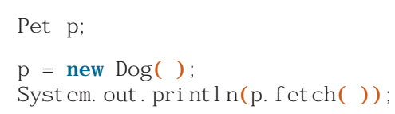
POLYMORPHISM
If a variable is declared of type S and is referring to an instance of a subclass of S, then we must typecast the variable to the subclass when calling noninherited methods of the subclass.
For example, the fetch method is defined in the Dog class only. So code such as
VALID? or INVALID?

Slide 14
POLYMORPHISM
If a variable is declared of type S and is referring to an instance of a subclass of S, then we must typecast the variable to the subclass when calling noninherited methods of the subclass.
For example, the fetch method is defined in the Dog class only. So code such as
INVALID!

Slide 15
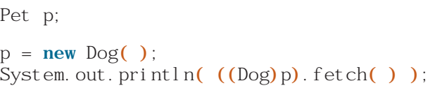
POLYMORPHISM
If a variable is declared of type S and is referring to an instance of a subclass of S, then we must typecast the variable to the subclass when calling noninherited methods of the subclass.
For example, the fetch method is defined in the Dog class only. So code such as
INVALID!
We must typecast p to Dog

Slide 16
POLYMORPHISM
Whenever we need to call a method unique to a subclass
we must typecast the variable to the subclass if the variable’s declared type is the superclass
A DOG IS A PET!
HOWEVER THE FETCH METHOD DOES NOT EXIST IN THE PET CLASS!
THEREFORE WE MUST TYPECAST p OBJECT TO DOG CLASS!

Slide 17
Hw
Create classes for Student, UnderGraduateStudent, GraduateStudent and PhDStudent

